Slide 1

Tetouan City Power Consumption
Mahi Patel , Rahee Chauhan, Usman Tahir, Mustafah Khan
Notes:
Good afternoon everyone.
Today our group will be presenting our project on power consumption in Tetouan City, which is a city in northern Morocco.
Basically we wanted to look at how weather affects how much electricity people use there.
So let’s get into it

Slide 2

Introduction and Motivation
Study power consumption in Tetouan City
Use weather data to predict electricity usage
Helps improve energy planning and efficiency
Important for smart cities and reducing waste
Notes:
"So, why did we even pick this topic? Well, electricity is something every city needs to manage carefully
. If you use too much, it can cause outages or waste.
If you plan it wrong, it gets really expensive.
What we wanted to do was look at whether — things like temperature, humidity, and wind — can help us predict how much power a city is going to use.
This kind of work matters a lot for building smarter, more efficient cities.
And honestly, with climate change making temperatures more unpredictable, it's becoming even more important."

Slide 3
Research Question
Main Question :
Which weather variables are the best predictors of Zone 1 power consumption in Tetouan City?
Predictor Variables Studied :
Temperature
Humidity
Windspeed
General Diffuse Flows
Response Variable :
Zone 1 Power Consumption
Notes:
our main research question was — which weather variables best predict Zone 1 power consumption in Tetouan City?
To answer that, we looked at three main weather factors: temperature, humidity, and wind speed — along with general diffuse flows.
And our response variable, basically what we're trying to predict, is Zone 1 power consumption.
So in simple terms, we just wanted to figure out — which of these weather factors has the biggest impact on how much power the city uses?"

Slide 4
Project Overview
Dataset Overview
Approx. 52,410 observations
Data collected every 10 minutes
Dataset includes weather measurements and electricity consumption in Tetouan City
Final cleaned dataset contained 13 variables after preprocessing
Modeling Setup
Response Variable: Zone 1 Power Consumption
Train/Test Split: 80% training, 20% testing
Random seed used: set.seed(2026)
Goal: Predict Zone 1 power consumption using weather variables
Models Used
Multiple Linear Regression
LASSO Regression
Decision Tree Regression
Evaluation Metric
Models compared using RMSE (Root Mean Squared Error) on the test dataset
Notes:
Moving on to project overview, we worked with a pretty large dataset — around 52,000 data points, each recorded every 10 minutes.
The data had both weather information and electricity usage for Tetouan City.
We did some cleaning on it, and after that we ended up working with 13 variables.
Our goal was to predict power consumption specifically in Zone 1.
To do that, we split the data into 80% training models, and the remaining 20% was used to test them.
We tried three different models: multiple linear regression, LASSO regression, and a decision tree.
And to figure out which one actually performed best, we used RMSE — basically, it measures how far your predictions are from the real values.
So the lower the RMSE, the better the model is doing.
13 variables:
Weather variables : Temperature, Humidity, Wind Speed, General Diffuse Flows, Diffuse flows
Power consumption : zone 1 power consumption, zone 2 power consumption, zone 3 power consumption
Time-related variables : hour, day, month,year, dateTime

Slide 5
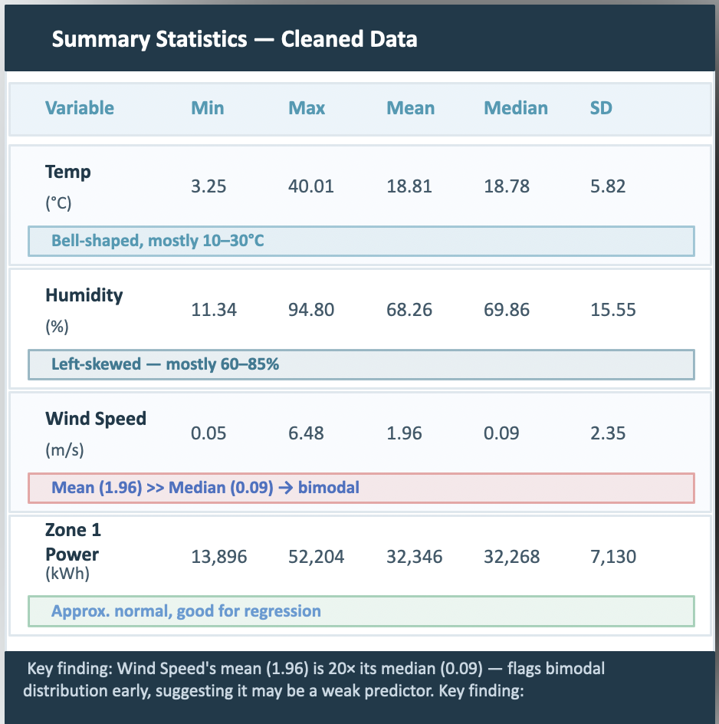
Data Cleaning
Loaded raw CSV file
Standardized names using make.names() so R could use column easily
Converted Data Time from text into data-time format
Checked missing values : only 6 rows had missing DateTime
Removes those rows because dataset is large
Checked for duplicates : none found
Added new columns : Hour, Day, Month, Year
Notes:
So before we could do any analysis, we had to actually clean the data.
So the first thing we did was we standardized the column names, basically the original dataset had spaces and special characters in the column names, so we fixed that so we could actually reference the columns easily in our code.
After that, we converted the DateTime column from plain text into an actual date-time format that R understands — because by default it just reads it as a string, which is useless for time-based analysis.
Then we checked for missing values... and we only found 6 rows with missing DateTime. Out of 52,000 observations, so we just removed those rows instead of imputing. We also checked for duplicates — and there were none, which was good.
And finally, we added some new columns — Hour, Day, Month, and Year — extracted from the DateTime.
Those could be useful as features later.
Now the summary statistics table on the right is actually see we have four main variables.Temperature — ranges from 3 to 40 degrees, mean around 18.8.
It's bell-shaped, mostly sitting in that 10 to 30 range.
Nothing weird there.
Humidity — ranges from 11 to 95 percent, mean around 68.
Left-skewed, mostly 60 to 85 percent.
Wind Speed is the one that stood out. Um, that's a massive gap between mean and median, which is a red flag for skewness or a weird distribution.
And that's exactly what flagged it early as potentially a weak predictor — before we even made any plots.And then Zone 1 Power — our response variable — ranges from about 14,000 to 52,000 kilowatt hours, with a mean around 32,000.
The mean and median are really close, which tells us it's approximately normal — and that's actually good for regression.
The key finding at the bottom kind of summarizes it — Wind Speed's mean being 20 times its median is basically the first signal that it might be a weak predictor.

Slide 6
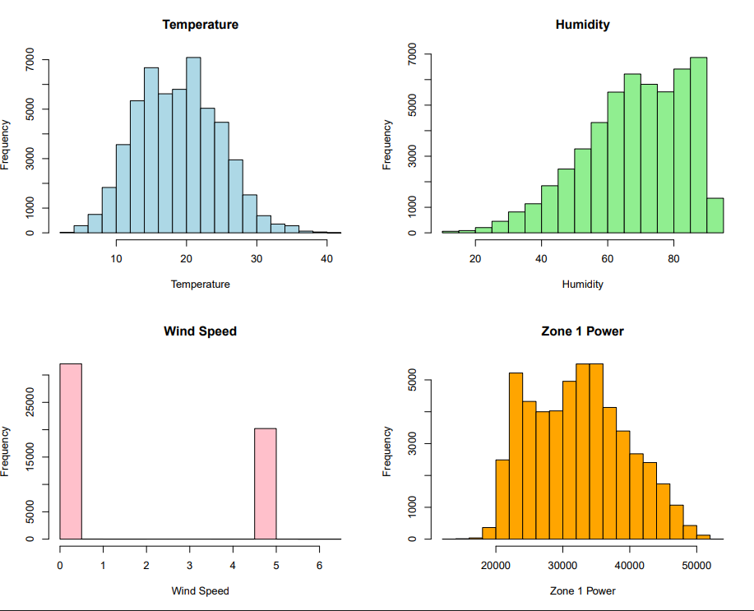
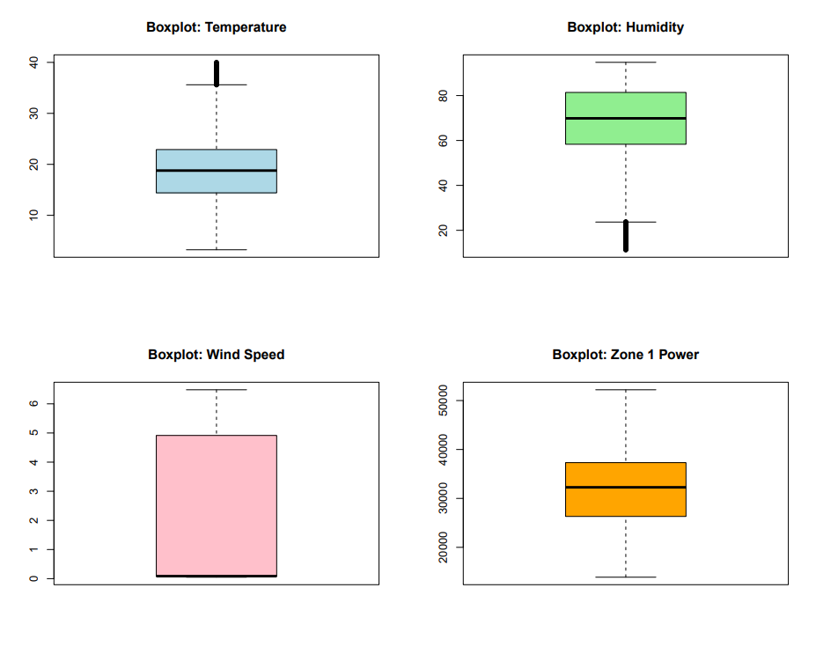
EDA – Variable Distributions
Key Findings
Temperature : Roughly bell shaped, ~19 C median. A few high temp outliers( > 36C)
Humidity : Left skewed, mostly 60-85%. Some extreme low outliers(~20%)
Wind Speed : Bimodal – clusters at 0 & ~5. Very little in between(unusual pattern)
Zone 1 Power : Approx. normal, centered ~32,000. No major outliers
Notes:
so, um... before we jump into any modeling, we first needed to understand what our data actually looks like.
So this is our EDA, So starting with Temperature... it's pretty bell-shaped, which is nice.
Most of our readings are sitting around 19 degrees Celsius, There are a few high outliers above 36 degrees — those are hot summer days, but they're real, so we kept them.
Humidity is a bit different — it's left-skewed, so most of the time it's pretty humid, like 60 to 85 percent.
But you can see some really low outliers down around 20% — those are the dry days.
Now... Wind Speed is the interesting one.
Um, if you look at it, it's bimodal — meaning there are two clusters, basically at 0 and then around 5.
There's almost nothing in between.
That's a really unusual pattern, and it kinda flagged early on that wind speed might be a weak predictor — because it's barely acting like a continuous variable.
And then Zone 1 Power — our response variable — that's approximately normal, centered around 32,000 kilowatt hours.
No crazy outliers, which is actually great for regression.

Slide 7
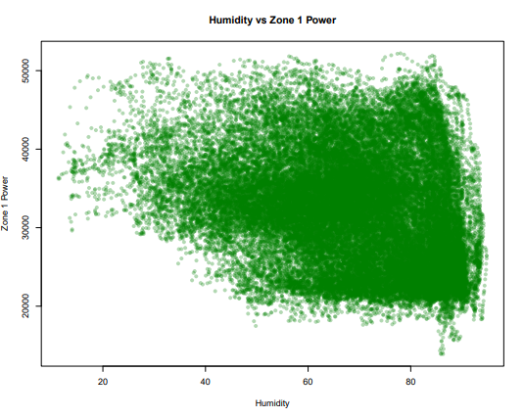
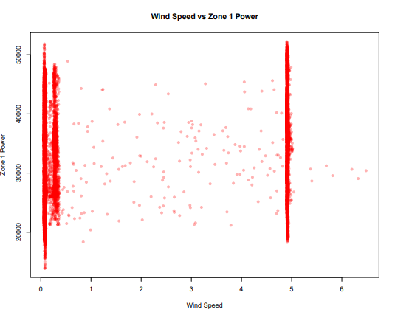
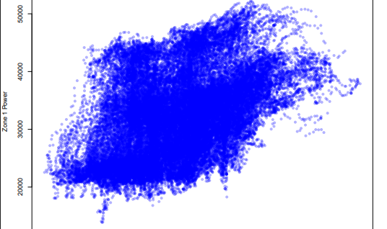
Predictor Relationships with Zone 1 Power
Temperature
Humidity
Wind speed
Strong Positive relationship.
Correlation is about +0.44
As temperature rises, power consumption generally rises.
Moderate negative relationship
Correlation is about -0.29
Higher humidity often appears with lower Zone 1 power.
Weak relationship overall
Points form vertical bands around 0 and 5
This suggests wind speed is recorded in discrete clusters.
Does not show clear linear pattern
Notes:
Next we made scatterplots to look at how each weather variable actually relates to Zone 1 power consumption.
Temperature — this one is the clearest.
You can see in the blue scatterplot there's a pretty obvious upward trend.
As temperature rises, Zone 1 power rises.
We calculated the correlation at about positive 0.44 — which is a moderately strong positive relationship.
This makes total sense hotter weather means more air conditioning, which means more electricity.
Humidity — this one shows a moderate negative relationship, with a correlation of about negative 0.29.
So higher humidity tends to go along with lower power consumption.
Part of the reason is that humidity and temperature are themselves negatively correlated here — when it's very humid, it tends to be cooler, and people use less power.
Wind speed — this one is a completely different story.
If you look at the red scatterplot, instead of a nice diagonal trend, you just see two vertical bands of points — one at 0 and one at around 5.
There's no clear linear pattern at all.
This confirms what we saw in the histogram — wind speed is recorded in discrete clusters rather than continuously — and as a result it shows a very weak relationship with Zone 1 power.
It's the weakest of the three predictors."

Slide 8
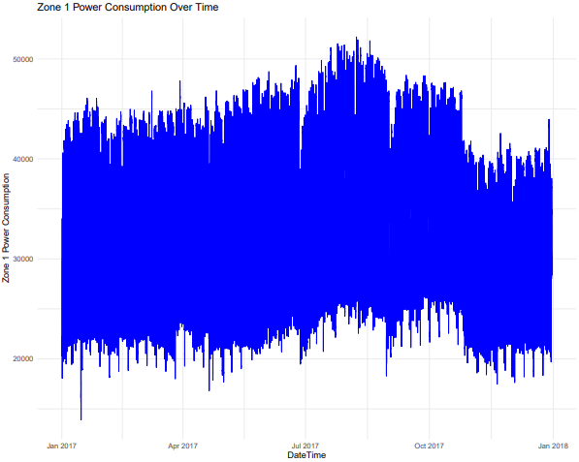
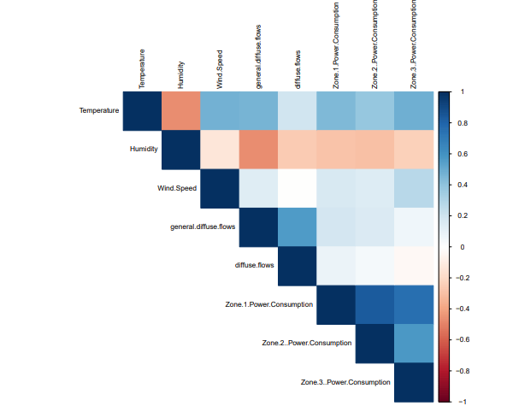
Correlation & Key Findings
Seasonal Pattern
Power peaks in Jul–Aug 2017 (summer AC use), dips in spring/fall.
Confirms temperature is a key driver of consumption.
Correlation Heatmap Takeaways
Temperature → Zone 1: strongest positive correlation
Humidity → Zone 1: moderate negative correlation
Wind Speed → Zone 1: near zero / very weak
Temperature & Humidity: negatively correlated with each other
Key Takeaway : Temperature is the strongest predictor, followed by Humidity. Wind Speed shows minimal predictive relationship with Zone 1 power.
Notes:
Okay so this slide kind of brings the EDA together.
We have two things here — the time series on the left, and the correlation heatmap on the right.
The time series just shows Zone 1 power over all of 2017.
And you can immediately see — power peaks in July and August.
That's summer in Morocco, people are blasting their AC, and consumption hits around 50,000 kilowatt hours.
Then it dips in spring and fall.
That seasonal pattern lines up perfectly with what temperature does throughout the year, which kind of confirms temperature is driving a lot of this.
And then the heatmap just... shows everything at once.
The darker the blue, the stronger the positive correlation.
You can see Temperature to Zone 1 has a pretty solid blue cell.
Humidity to Zone 1 is more of a salmon-pink — that's the negative correlation, moderate strength.
And Wind Speed to Zone 1 is basically white... near zero.
Um, one other thing — you can see Temperature and Humidity are negatively correlated with each other, which makes sense.
Hot days tend to be dry days.
So the key takeaway is that Temperature is the strongest predictor, Humidity is moderate, and Wind Speed is basically minimal.
That finding from EDA will hold up all the way through our models.

Slide 9
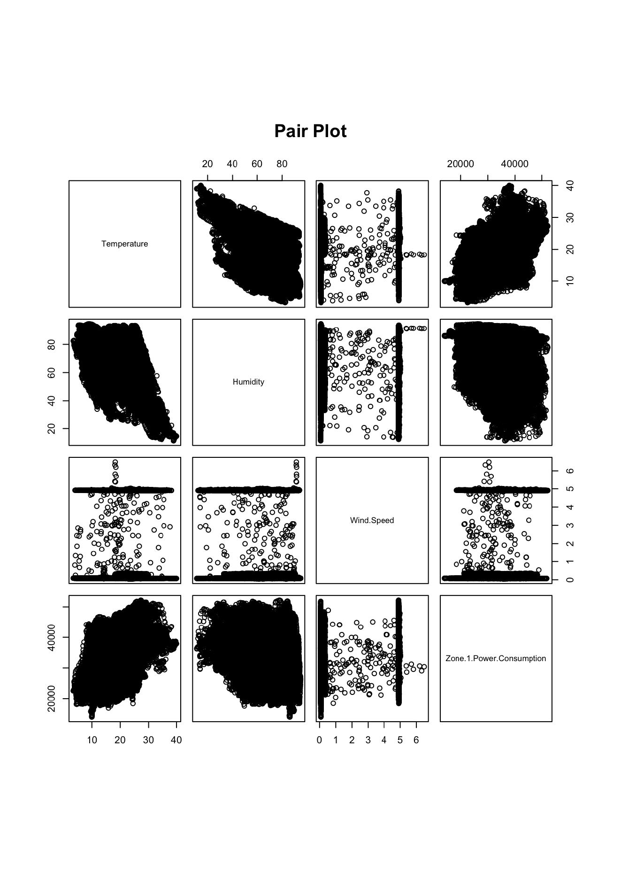
Pair plot : all Main relationship
Each small panel compares two variables
Temperature vs Zone 1 power shows an upward trend
Humidity vs Zone 1 power shows downward trend
Wind speed shows two distinct vertical bands
Temperature and Humidity are negatively related.
Notes:
On this slide, we can see the pair plot, which basically compares every variable with one another.
Instead of looking at separate graphs one by one, this gives us an overall picture of how the variables are related.
One important pattern we noticed is between temperature and Zone 1 power consumption. The points move upward, which shows that when temperature increases, power consumption also tends to increase.
For humidity, we see more of a downward trend with Zone 1 power. So higher humidity is generally linked with slightly lower power consumption.
Wind speed is interesting because the points form two vertical groups, mainly around 0 and 5. That suggests the wind speed values were recorded in clusters rather than continuously, and it also explains why wind speed did not show a strong relationship with power usage.
Another thing we noticed is that temperature and humidity are negatively related. In general, when temperature goes up, humidity tends to go down.
Overall, this pair plot helped us visually confirm the relationships we observed earlier in the EDA.”

Slide 10
Model Building
LASSO Regression
Decision Tree Regression
Multiple Linear Regression
Interpretable baseline model using linear relationships and coefficients.
Predictors : Temperature, Humidity, Wind, Speed, general diffuse flows, diffuse flows
Regularized regression that can shrink weak coefficients and help with variable selection
Tuning : lambda selected using cross - validation
Nonlinear if-then model that splits data into groups and predicts average power in each leaf
Tuning : complexity parameter cp and pruning.
Evaluation step : 80% training data, 20% test data. All models used the same split and were compared using RMSE.
Notes:
After exploring the data, the next step was building prediction models.
We used three different regression methods to predict Zone 1 power consumption.
The first model was Multiple Linear Regression. We used this as our baseline model because it is simple, easy to interpret, and shows how each predictor affects power consumption.
The second model was LASSO Regression. This is similar to linear regression, but it adds regularization. In simple words, it can reduce the impact of weaker variables and helps prevent overfitting.
The third model was Decision Tree Regression. Unlike linear models, this method captures nonlinear relationships by splitting the data into groups using if-then rules.
For all three models, we used the same predictors: temperature, humidity, wind speed, general diffuse flows, and diffuse flows.
We also used the same train-test split for fair comparison, where 80% of the data was used for training and 20% for testing.
Finally, we compared the models using RMSE, which measures prediction error. Lower RMSE means better prediction performance.”

Slide 11
Multiple Linear Regression
Model Performance
R² = 0.206
Test RMSE = 6305.16
All predictors except Diffuse flows were statistically significant (p < 0.001)
Model explains about 20.6% of variation in Zone 1 power.
Thus, temperature had largest positive effect, so it is strongest predictor in linear model
Predictor | Coefficient | Interpretation
Temperature | 535.70 | Strongest +ve effect
Humidity | -55.70 | Moderate –ve effect
Wind speed | -153.57 | Small –ve effect
General Diffuse Flows | -1.67 | Very small –ve effect
Diffuse flows | -0.17 | Not significant
Model Equation (Linear Regression)
Zone 1 Power=β0​+β1​(Temperature)+β2​(Humidity)+β3​(Wind Speed)+β4​(General Diffuse Flows)+β5​(Diffuse Flows)+ε
Notes:
Here we have the results from the Multiple Linear Regression model.
The model achieved an R-squared value of about 0.206. This means the model explains around 20.6% of the variation in Zone 1 power consumption.
The test RMSE was about 6305, which became the lowest among all three models we tested.
We also found that almost all predictors were statistically significant, except diffuse flows.
Among all variables, temperature had the strongest positive effect on power consumption. This matches what we observed earlier in the EDA and correlation analysis.
So overall, the linear regression model performed the best while also remaining easy to interpret, which makes it useful for understanding the relationship between weather and power usage.”

Slide 12
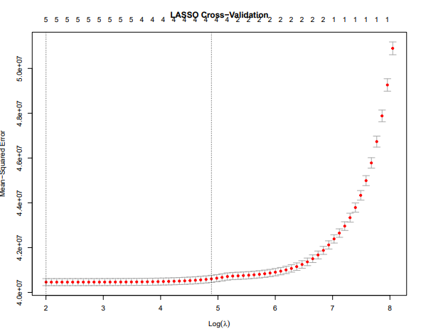
LASSO Regression Result
Key Findings
Best Lambda selected : 7.4028
Kept all five predictors, meaning none were shrunk completely to zero
Temperature remained the strongest predictor
Test RMSE = 6305.17
It performed nearly the same as Multiple Linear Regression while helping reduce overfitting
Notes:
Next, we tested the LASSO Regression model.
The best lambda value selected through cross-validation was around 7.4. Lambda is basically the tuning parameter that controls how strongly the model shrinks coefficients.
Interestingly, LASSO kept all five predictors in the model, meaning none of the variables were completely removed.
Temperature still remained the strongest predictor, which was consistent across all our analyses.
The test RMSE was almost the same as Multiple Linear Regression, around 6305 as well.
So even though LASSO did not improve prediction accuracy much, it still helped by reducing the risk of overfitting and making the model more stable.”

Slide 13
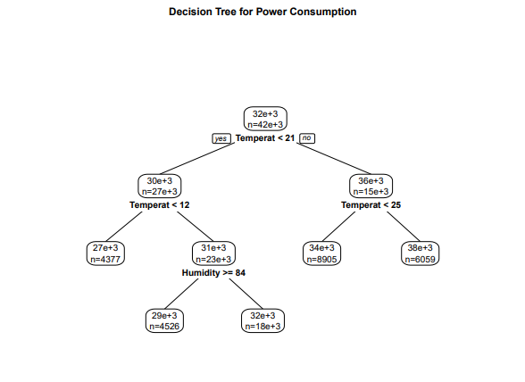
Decision Tree Results
Key Findings
Tree mainly used Temperature and Humidity for splits
Other variables(Wind speed, diffuse flows) were not important
Captures nonlinear relationships in the data
Produces simple if-then decision rules for prediction
Model Performance
Total RMSE : 6325.27
Notes:
This slide presents the Decision Tree Regression results.
The RMSE for this model was slightly higher, around 6325, so it performed a little worse compared to the regression models.
The tree mainly used temperature and humidity to make splits, which again shows these were the most important predictors.
Variables like wind speed and diffuse flows did not contribute much to the decision-making process.
One advantage of decision trees is that they can capture nonlinear relationships and create simple if-then prediction rules.
However, in our case, the decision tree did not outperform the linear models in prediction accuracy.”

Slide 14
Conclusion & Recommendation
Answer to Research Question
Temperature is the strongest predictor of Zone 1 power consumption. Humidity is a moderate predictor and wind speed is the weakest main weather predictor
Best Model
Best Predictor
Model Limitation
Multiple Linear Regression had the lowest RMSE and its interpretable
Temperature had the clearest EDA pattern and strongest model effect
R² around 0.206 means weather explains part of power use, but not all of it
Possible Improvements
Add Hour, Month and Day of week into the models; test interactions like Temperature X Humidity; try Random Forest or boosting; compare Zone 1, Zone 2 and Zone 3 separately.
Notes:
To conclude our project, Multiple Linear Regression turned out to be the best-performing model because it had the lowest RMSE and was also easy to interpret.
Across all analyses, temperature consistently appeared as the strongest predictor of Zone 1 power consumption.
Humidity showed a moderate effect, while wind speed had the weakest relationship overall.
One limitation of our study is that the R-squared value was only around 0.206. This tells us that weather variables explain only part of the variation in electricity consumption, and there are likely other important factors involved.
Some possible improvements for future work would be adding variables such as hour, month, or day of the week, testing interaction effects like temperature multiplied by humidity, and also trying more advanced models such as Random Forest or Boosting.”

Slide 15
Future Works
Add more features
Include time-based variables like Hour, Day of Week, and Season
These can capture daily and weekly usage patterns
Try advanced models
Use Random Forest and Gradient Boosting
These can capture nonlinear patterns better than linear models
Improve accuracy
Incorporate non-weather factors
Holidays
Human activity patterns
Energy demand trends
Notes:
So finally, to answer our research question:
Temperature is the strongest predictor of Zone 1 power consumption in Tetouan City.
Humidity also has some predictive value, but its effect is weaker compared to temperature.
Wind speed showed very little predictive power and had the weakest relationship overall.
In the future, this research could be expanded by comparing all three power zones separately and by including additional time-based variables to improve prediction accuracy.
Overall, our project showed that weather conditions, especially temperature, play an important role in understanding electricity usage patterns.”

Slide 16
Thank you for listening to us !
Any Questions?

